Slide 1

Release V1.8 – Prepare script refactor
Meeting Host
Weiwei He (github:heww)
Harbor team member

Slide 2
Agenda
V1.9 feature and story progress (5 minutes)
Community update (10 minutes)
Feature demo
System level CVE whitelist - Daniel Jiang (5 minutes)
External syslog driver - Qian Deng (5 minutes)
Webhook progress - Mingming Pei (5 minutes)
User case sharing from qihoo360 (Frank Kong) (10 minutes)
Free talk: any community/project topics discussions (3 minutes)

Slide 3
V1.9 feature and story progress
Feature and Story | Progress
Quota per project | Coding
Tag retention | Proposal ready and begin to code
Replication improvement story | ECR, GCR, Azure ACR adapters support done Replication by label added back
Webhook support | Mingming Pei will share the progress later
Whitelist in CVE | System CVE whitelist ready
sysLog endpoint for log shipping | Done in next sprint
Performance/scalability improvement | Done for performance test stage 1

Slide 4
Harbor in KubeCon Shanghai
KubeCon China @ Shanghai June 24 – Jun 26
Harbor maintainer gathering
Harbor community event with other CNCF projects( Dragonfly, TiKV )
Harbor session by Steven Zou & Wenkai Yin
Harbor maintainers met users at the booth

Slide 5
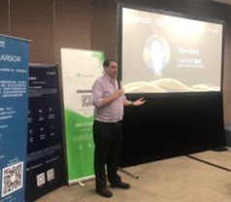
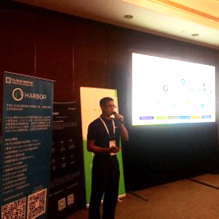
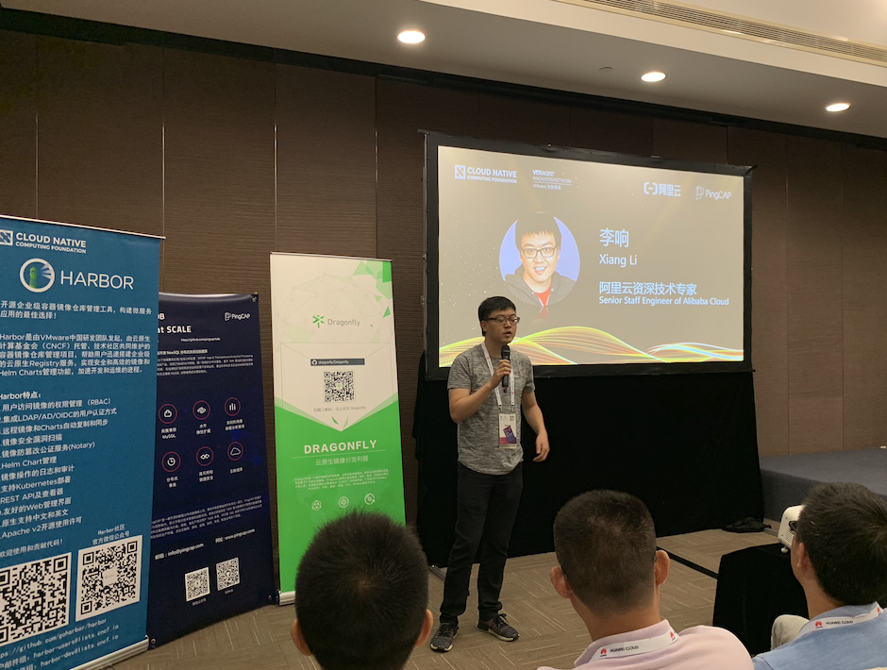
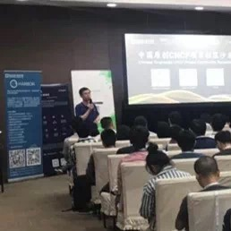
Harbor Community Event - Chinese-Originated CNCF Project Community Reception
Maintainer gave project update
Users shared Harbor experience
Kicked off by Dan Kohn, Alan Ren and Xiang Li
Dan Kohn,
CNCF Executive Director
Alan Ren,
GM of VMware R&D China
Xiang Li,
CNCF TOC member
Henry Zhang,
Founder of Project Harbor

Slide 6
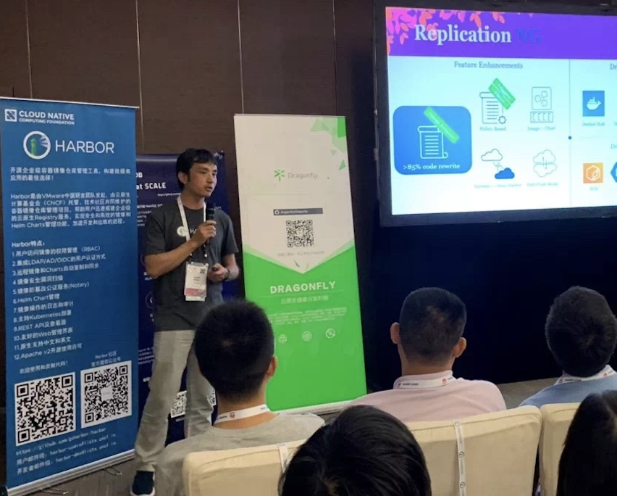
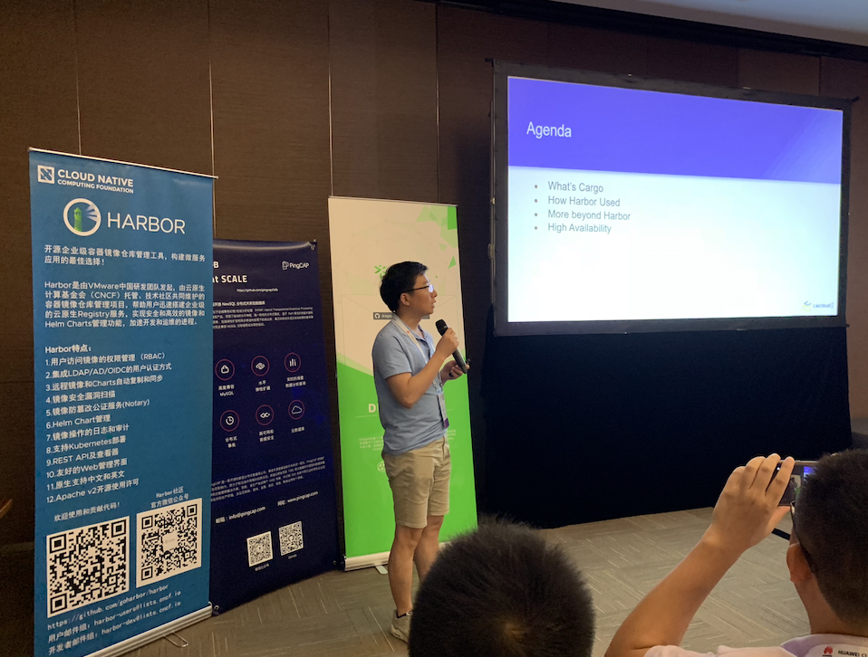
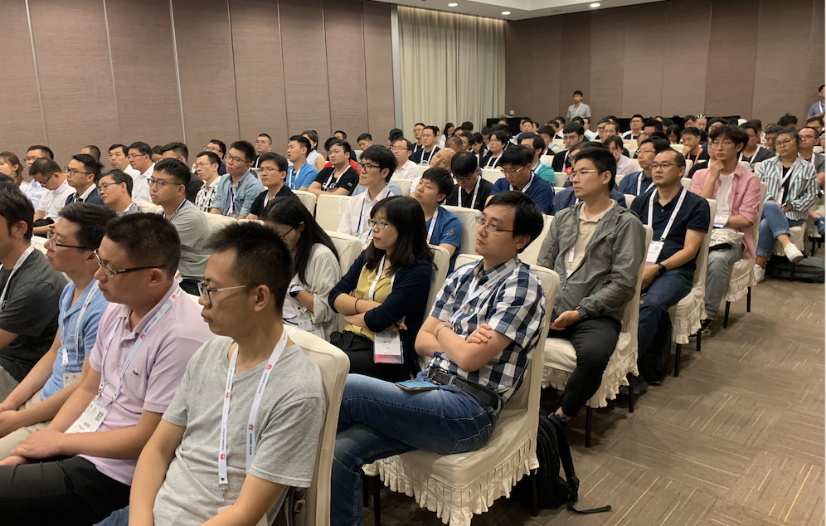
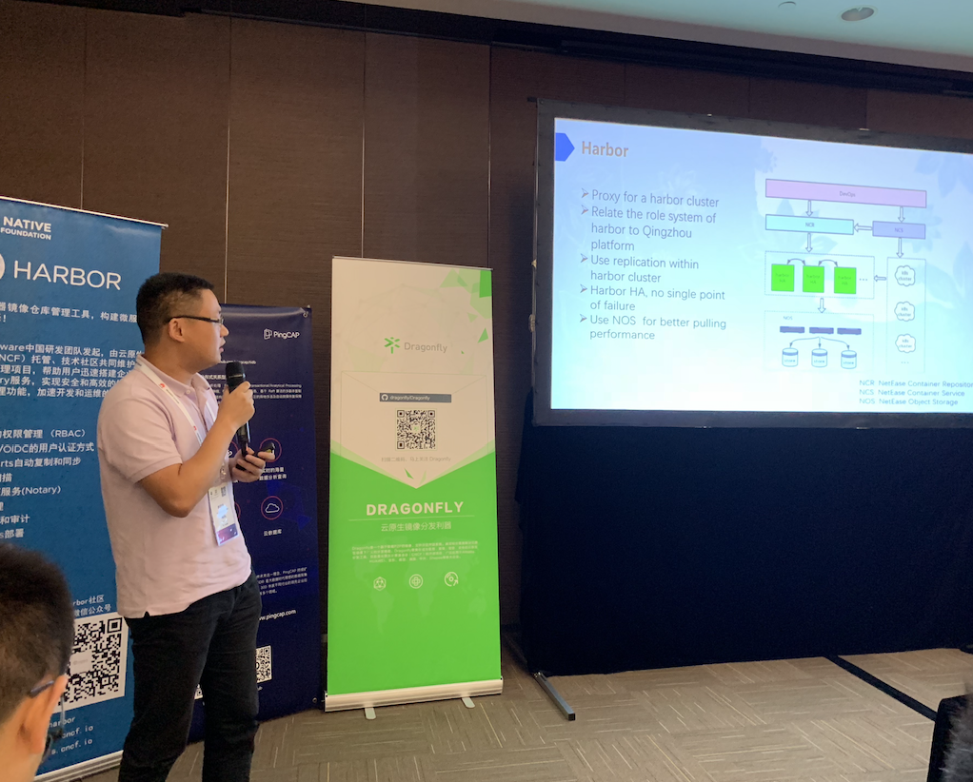
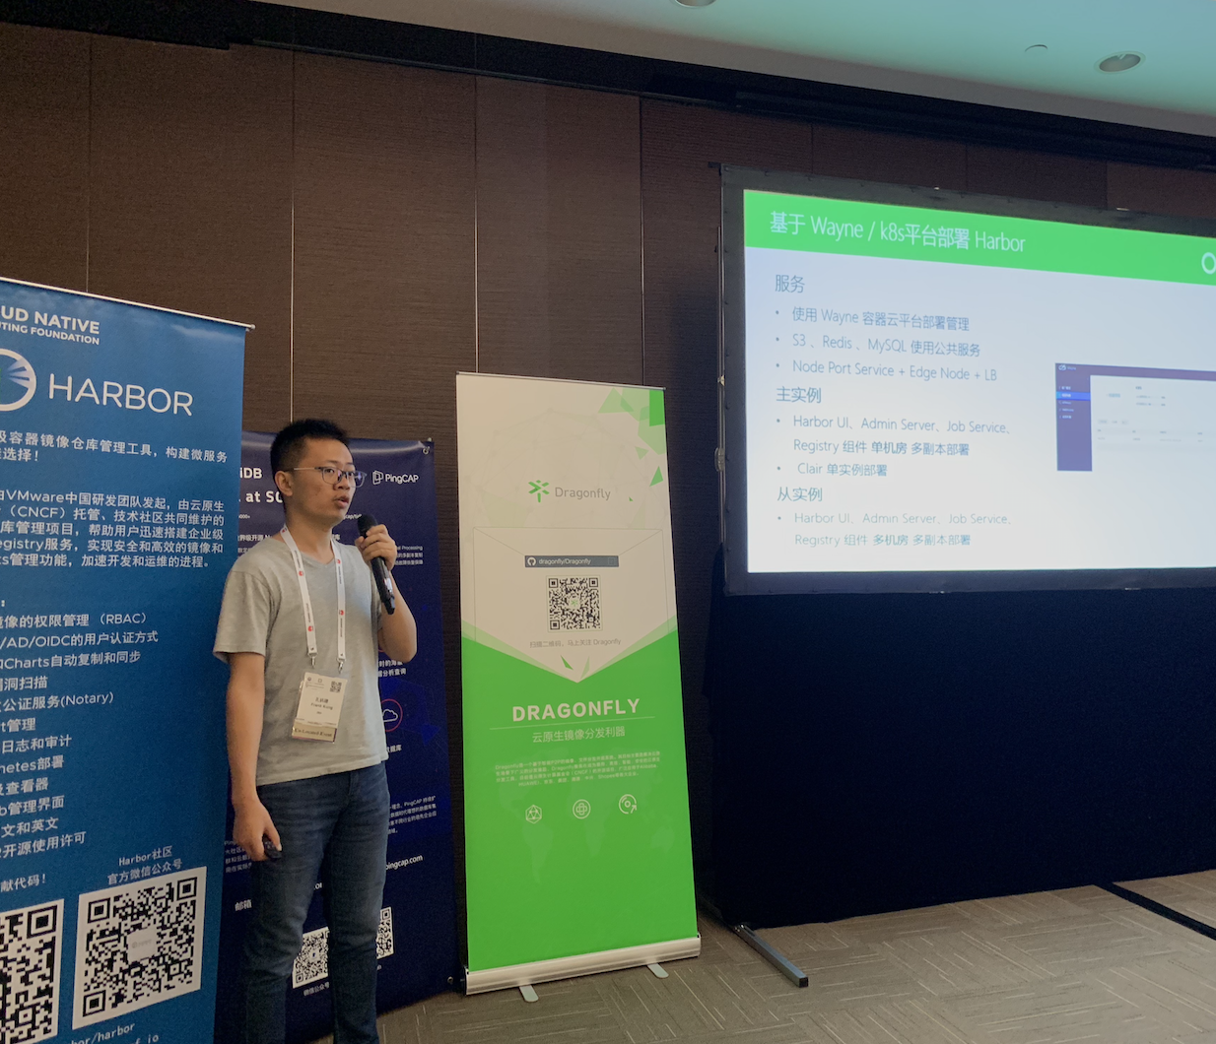
Harbor Community Event
Maintainer sharing at the event
Steven Zou, VMware
De Chen, CaiCloud
Mingming Pei, Netease
Frank Kong, Qihoo 360

Slide 7
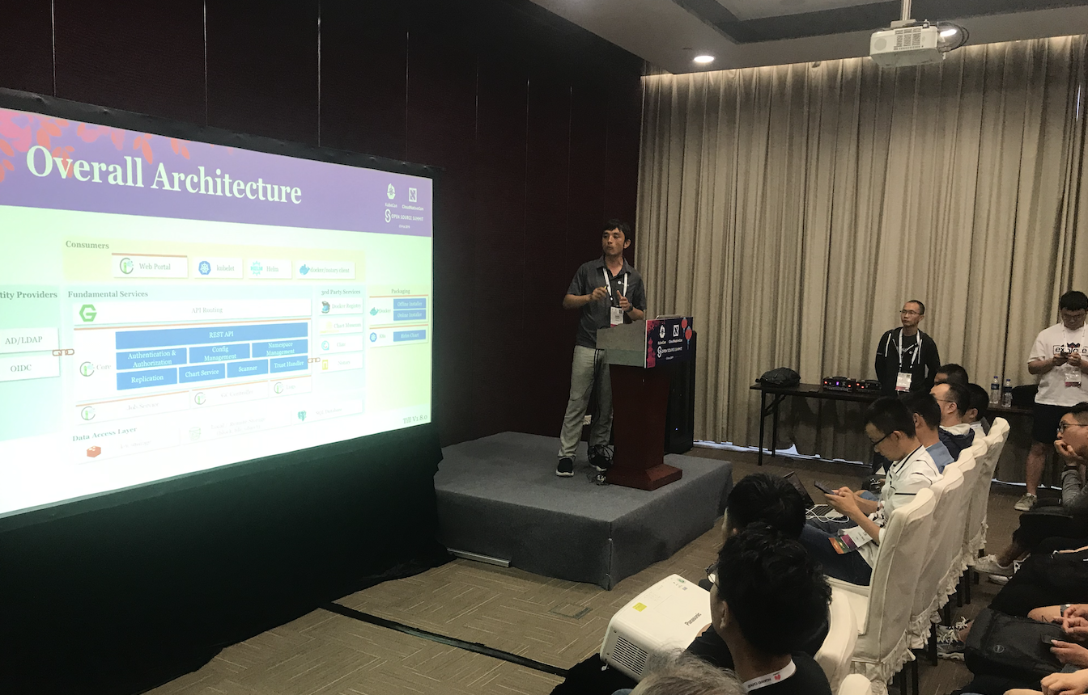
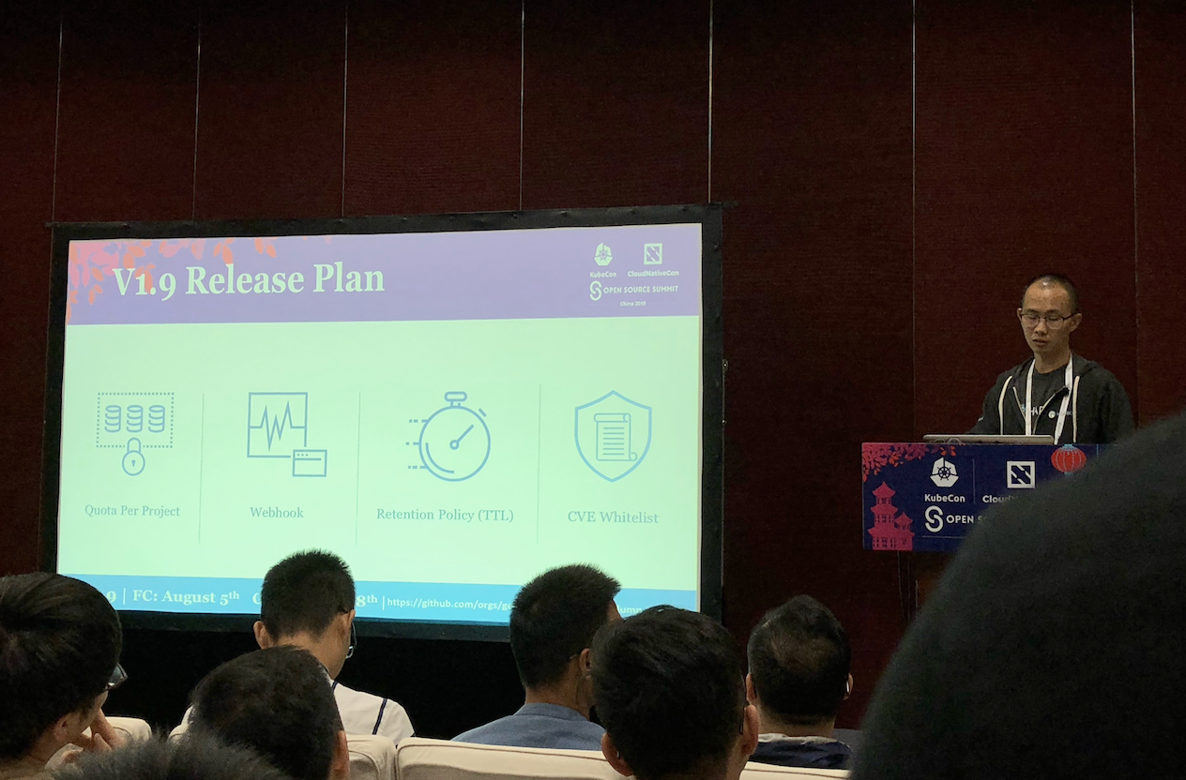
Harbor session @ KubeCon Shanghai
Delivered by maintainer Steven Zou and Wenkai Yin

Slide 8
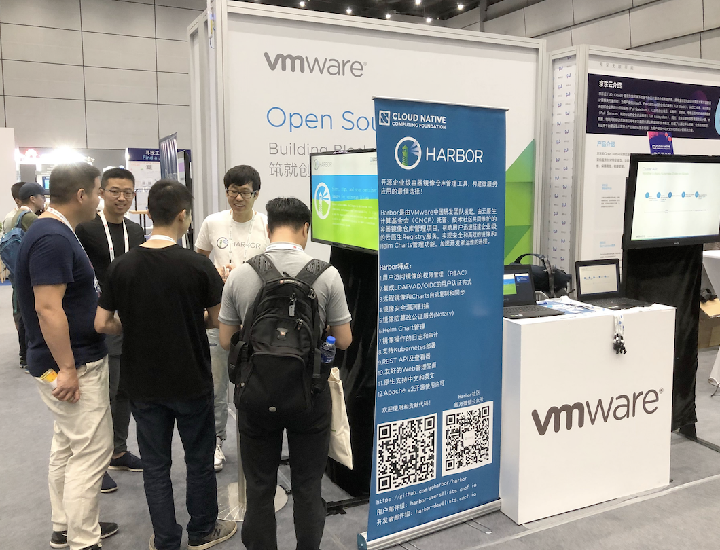
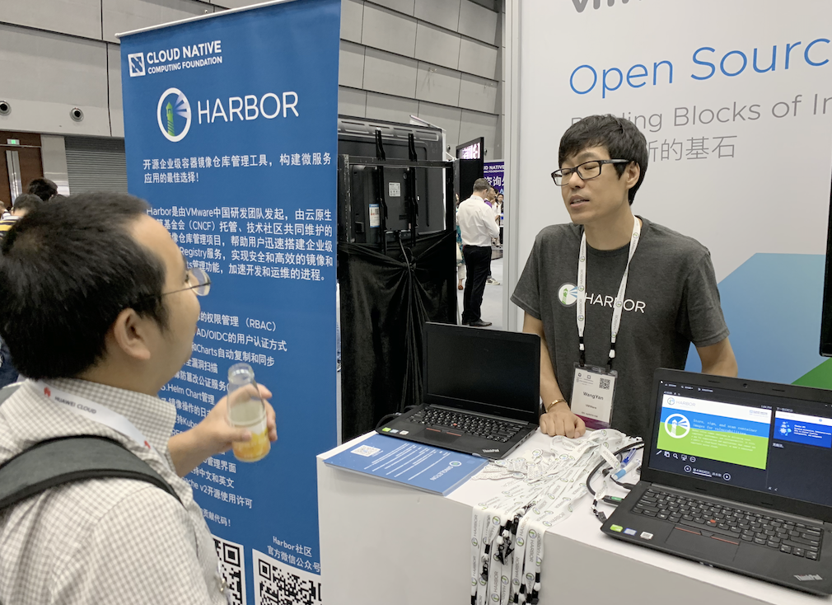
Harbor @ the Booth, KubeCon Shanghai
Met 100+ users at the booth
Thanks for all the great feedback
Discussed collaboration in community

Slide 9
Upcoming community events
KubeCon San Diego CFP by July 12
Welcome to share any Harbor use cases in KubeCon
Talk to us if you have any topic ideas
Planning for offline meetups in a few cities in China
Requested by many Harbor users
Meetup venues can be sponsored
Let us know your cities and we can plan for it

Slide 10
Feature Demo
System level CVE whitelist (Daniel Jiang)
External syslog driver (Qian Deng)
Webhook progress (Mingming Pei)

Slide 11
User case sharing
User case sharing from qihoo360 in Chinese (Frank Kong)

Slide 12
Topics?
Any topics to discuss here?

Slide 13
Meeting minutes
Meeting is recorded and the recording link will be updated to the meeting schedule doc later: https://github.com/goharbor/community/blob/master/MEETING_SCHEDULE.md
The meeting slides will be uploaded to the community repo https://github.com/goharbor/community and put under the ‘conf-calls’ folder.

